Slide 1
ASHRAE Great Energy Prediction
Group 10:
Tran Hieu Le
Voratham Tiabrat

Slide 2
Introduction
According to NASA report, the carbon dioxide level was always below 300 parts per million for millennia.
However, since 1950 the level has been rapidly increasing, and reaches approximately 415 parts per million nowadays.
One of the main factors to the increase of carbon dioxide level is the energy consumption of industrial buildings.
Significant investments have been made to improve energy efficiencies.
The main challenge is whether the improvements reduce energy costs and emission.

Slide 3
Scope and Objectives
A solution is to build a counterfactual machine learning model to forecast the amount of energy consumption for the original building using historic usage rates.
The forecasts are compared to the actual energy consumption to calculate the savings after retrofits.
AWS is used to provide more computational power and speed to deal with with our big data (approximately 20 million observations and 15 features).
Python is the main programming language. SQL is used for general data analysis.

Slide 4
Data source
The dataset for this project comes from a Kaggle competition hosted by ASHRAE.
https://www.kaggle.com/c/ashrae-energy-prediction/overview
building_meta.csv: contains buildings’ information
train.csv: contains the energy consumption and energy type for buildings
weather_train.csv: contains the weather status based on locations and timestamp

Slide 5
AWS Cloud Services
S3 bucket: stores datasets for AWS Athena and AWS Sagemaker, stores results from AWS Athena SQL queries, hosts a static website.
AWS Athena: quickly analyzes large datasets, joins multiple datasets
VPC: controls network access and internet connectivity of Sagemaker notebooks, provides private subnet to block unintended download of malicious code and unauthorized access, allows security in depth.
AWS Sagemaker: data preprocessing, training and hyperparameter tuning models.

Slide 6
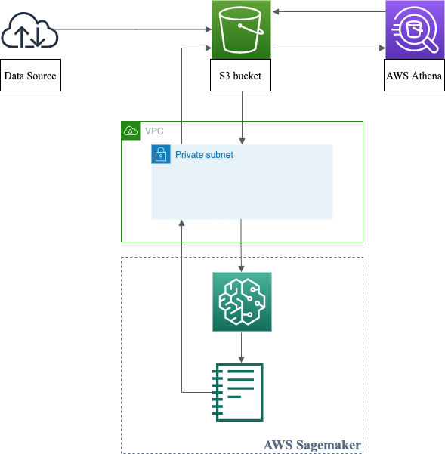

Slide 7
Demo

Slide 8
Outcomes
Empirical experience in using AWS services to solve a big data problem.
Using VPC to manage actions in AWS services and connectivity to systems.
Understanding to use AWS Athena to create tables, handle multiple datasets from S3 bucket, and use SQL syntax for data analysis.
Knowing to use AWS Sagemaker for data preprocessing and building ML models.

